Slide 1
Vehicle Damage Insurance Classification using ConvNeXt
Yarden Shavit
Dor Yogev
Ravid Goldenberg

Slide 2
Overview
Fine-tune a pre-trained CNN for identifying types of vehicle damage from images
Streamline insurance claims process, reduce fraud, improve customer experience

Slide 3
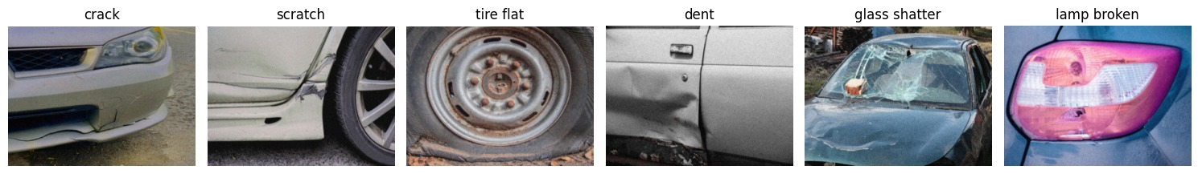
Dataset
Vehicle Damage Insurance Verification dataset
The dataset comprises 7,200 images, categorized into six distinct classes: dent, scratch, crack, glass shatter, lamp broken, tire flat

Slide 4

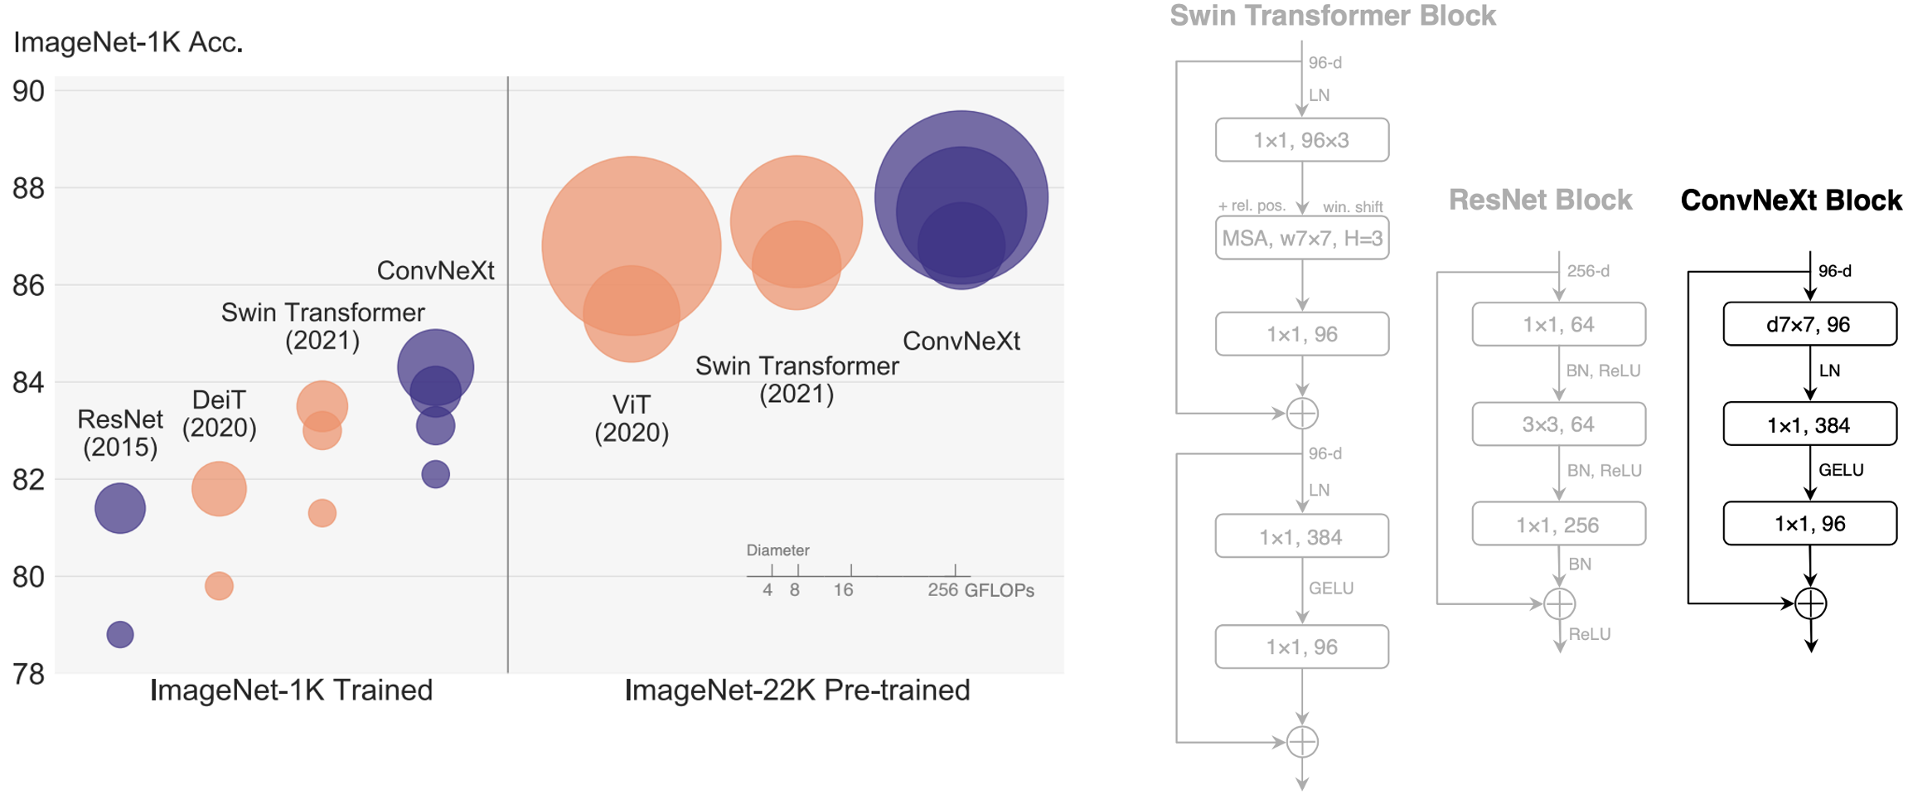
Methodology
Fine tuning the last stage of ConvNeXt network
ConvNeXt is a state-of-the-art convolutional neural network architecture introduced by Facebook AI Research in 2022. It was designed to bridge the gap between convolutional neural networks (CNNs) and vision transformers (ViTs), combining the best aspects of both approaches.

Slide 5
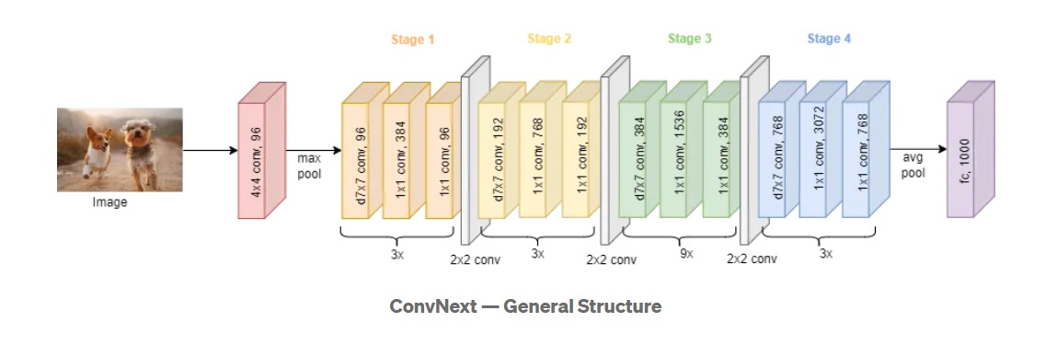
Methodology
ConvNeXt network

Slide 6
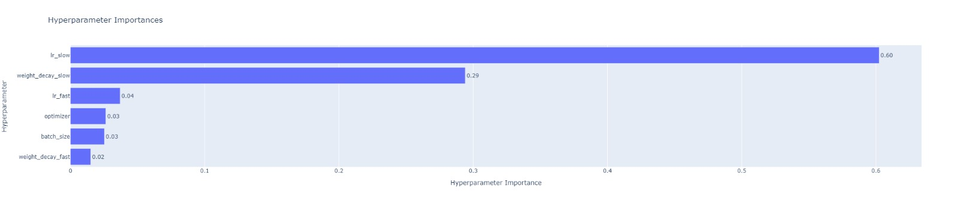
Hyperparameter Optimization
Optuna with 200 trials, 10 epochs per trial
Optimized learning rates, optimizer type, weight decay, batch size
Split optimizers: One for final FC layer, one for stage layers

Slide 7
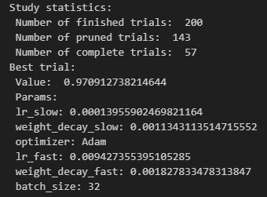
Optuna Results

Slide 8
Training Process
200 epochs total
Cross-entropy loss function
To address the limitations of the small dataset, we applied data augmentations: ColorJitter, RandomHorizontalFlip, RandomAffine, RandomGaussianNoise, RandomCrop
Accuracy evaluation on validation set
MultiStepLR scheduler: Learning rate reduction at 75 and 150 epochs

Slide 9
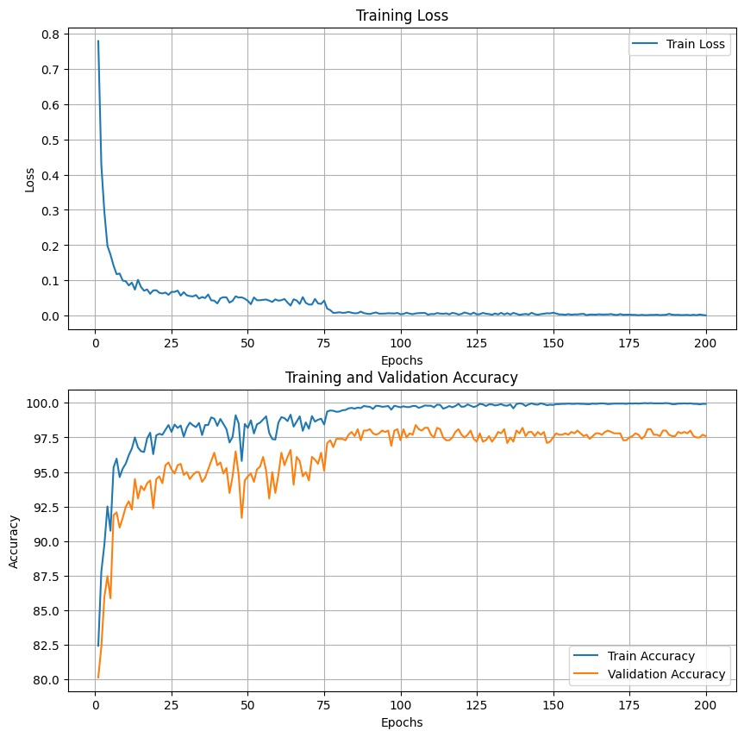
Training Process

Slide 10
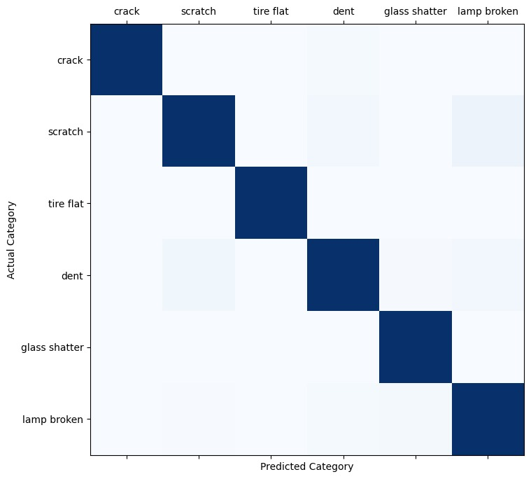
Results
Train accuracy: 99.771%
Best validation accuracy: 98.395% (epoch 105)
Test accuracy: 97.328%
Common misclassifications: Dent vs. Scratch, Lamp Broken vs. Scratch

Slide 11
Future Work
Fine-tuning more stages of ConvNeXt
Exploring alternative architectures
Combining multiple models for improved performance

Slide 12
Conclusion
Successfully fine-tuned ConvNeXt for car damage classification: Achieved 97.328% accuracy on test set
Insights: Importance of separate learning rates for different parts of the model ConvNeXt architecture shows competitive performance compared to EfficientNet
Potential Impact: Streamlined insurance claim processes Enhanced efficiency for car repair diagnostics Improved customer experience in damage assessment

Slide 13
THANK YOU

